Slide 1
Jermyn Borough Council Meeting
04/18/2024

Slide 2

Meeting Agenda
April 18,2024
CALL TO ORDER
PLEDGE OF ALLEGIANCE
ROLL CALL
PREVIOUS MEETING MINUTES
TREASURER REPORT/BILLS PAYABLE
SECRETARY REPORT
CORRESPONDENCE
PUBLIC COMMENT
PROFESSIONAL REPORTS-POLICE, FIRE, SOLICITOR, ZONING, ENGINEER, TAX COLLECTOR, MAYOR
COMMITTEE REPORTS-SAFETY, PLANNING, FINANCE, SHADE TREE, REC, MS4, DPW
PURCHASE OF LED LIGHTS FOR BASKETBALL COURT
ADVERTISEMENT OF OPEN COUNCIL SEAT
RUSHBROOK RESOLUTION
REVISED GARBAGE ORDINANCE
NEW BUSINESS

Slide 3
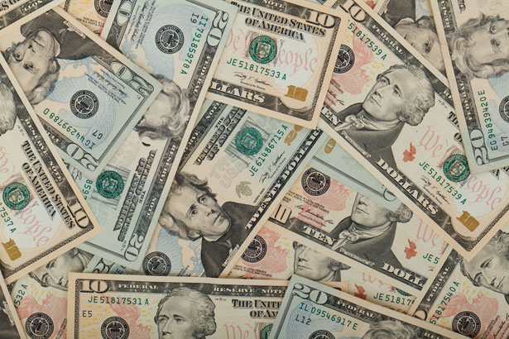
Treasurer’s report
3/21/2024
ASSETS
Checking/Savings
American Rescue Plan Fund 135,750.78
Capital Reserve - DPW 909.55
Capital Reserve - Police 5,439.82
Crime Watch Fund 222.69
General Fund - Community 51,596.51
General Fund - FNB 5,946.20
Holiday Lights Fund 1,459.09

Slide 4
Treasurer’s report
Investment - General Fund 1,078.38
Investment - Liquid Fuels 23,743.85
Investment - Paving Fund 1,089.61
Investment - Recycling 119.09
Investment - Refuse 169.82
Liquid Fuels - FNB 62,427.90
Petty Cash 196.50
Recreations Fund 27,197.24
Recycling - Community 3,468.14
Refuse Checking - FNB 36,661.18
Total Checking/Savings 357,476.35

Slide 5
Treasurer’s report
200000 · Accounts Payable 14,004.26
Long Term Debt 164,055.99

Slide 6
MS4 Minute
https://www.youtube.com/watch?v=sBhzpZD8i8s

Slide 7


